Slide 1
Transportation
Back to School
- Timothy Shannon, Director Transportation Services

Slide 2
Safe Transportation
As we return to school we want to inform students, parents and staff of the steps we are taking as the situation around COVID-19 changes.
Transportation Services is taking our communities health and safety seriously and making it a top priority.

Slide 3
Bus Sanitizing
Daily Cleaning/Deep sanitizing, product information
– Raymond Manalo, Manager Fleet Services

Slide 4
Bus Sanitizing Guidelines
Deep cleaning, disinfecting/Sanitizing Steps
Sanitizing of the buses will be done daily after the completion of routes. Buses will receive deep cleaning at the end of the day on Wednesdays and Fridays.
Wear appropriate Personal Protective Equipment (PPE) as needed during this process. Remove and discard large items and trash. Open all windows. Vacuum floors and seats. Pay particular attention to the crevices between the wall and the seat. Lift the seat bottom to clean between the top and bottom sections of the seat. Wipe down the entire bus interior using paper towels and cloth towels using the Spirit II cleaner/ disinfectant.

Slide 5
Bus Cleaning Guidelines
Bus drivers steps to be taken between students (runs) pick ups
Following the morning and afternoon runs -
Drivers are responsible for the following: Sweep bus of large trash. (Do not sweep items from bus floor into the bus yard.) Remove all trash from bus and place in trashcans or dumpster. Ensure the bus is clean before beginning disinfecting procedures. Wipe down high touch surfaces such as handrails, seats (especially seat tops), and windows: drivers compartment; seat belt, steering wheel, all switches and controls, microphones. Use ZEP Spirit II and clean paper towels or cleaning cloth. Dispose of paper towels in trashcans or dumpster. Use separate towels for cleaning and disinfecting. Document and sign on the back of the Daily Vehicle Inspection Report (DVIR) each time these procedures are completed throughout the day.

Slide 6
Product information – Disinfectant
Virucidal | Kills HIV-1, HBV, Influenza A, Norovirus, Canine Parvovirus, has demonstrated effectiveness against viruses similar to 2019 Novel Coronavirus (SARS- CoV-2) COVID-19 and more. EPA registered Reg # 1839-83-1270
Color | Clear, Colorless
Fragrance | Citrus (Lemon- like)
Flash Point | N/A
No Rinsing Required | Just spray and wipe off. Except on food-contact surfaces.

Slide 7
Rider Procedures
COVID 19 Safety Protection Guidelines for parents, students and drivers – Nancy Jensen, Ca State Certified School Bus Driver Instructor

Slide 8
Steps prior to boarding
Parents, students and driver responsibilities
Parents will screen their students at home using a template provided to them. A temperature check is part of this screening.
Drivers will visually/passive screen looking at students for signs of illness.
At the bus stop and on the bus:
Students must wear a mask at all times. If a student needs a mask, one will be provided.
Students will scan on and off the bus using provided school bus pass card
Students will following the loading and seating directions given by the drivers. Students will sit in marked seats only and wear a seatbelt if present.
Students will be seated from the back of the vehicle toward the front alternating - No Exceptions.
At large bus stops, younger students will line up at the end of the line when waiting to load the school bus, so they end up in the front of the bus.

Slide 9
Student suspected of being ill (TBD)
Parents, students and driver responsibilities
Procedures for when a student is suspected of being ill at the school bus stop or school site before boarding school bus. (TBD)
Notes:
Waiting on information from Health Services Department.

Slide 10
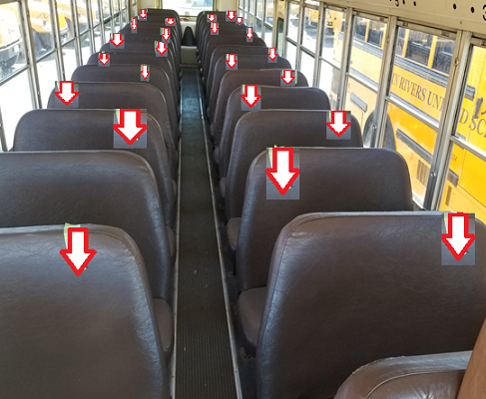
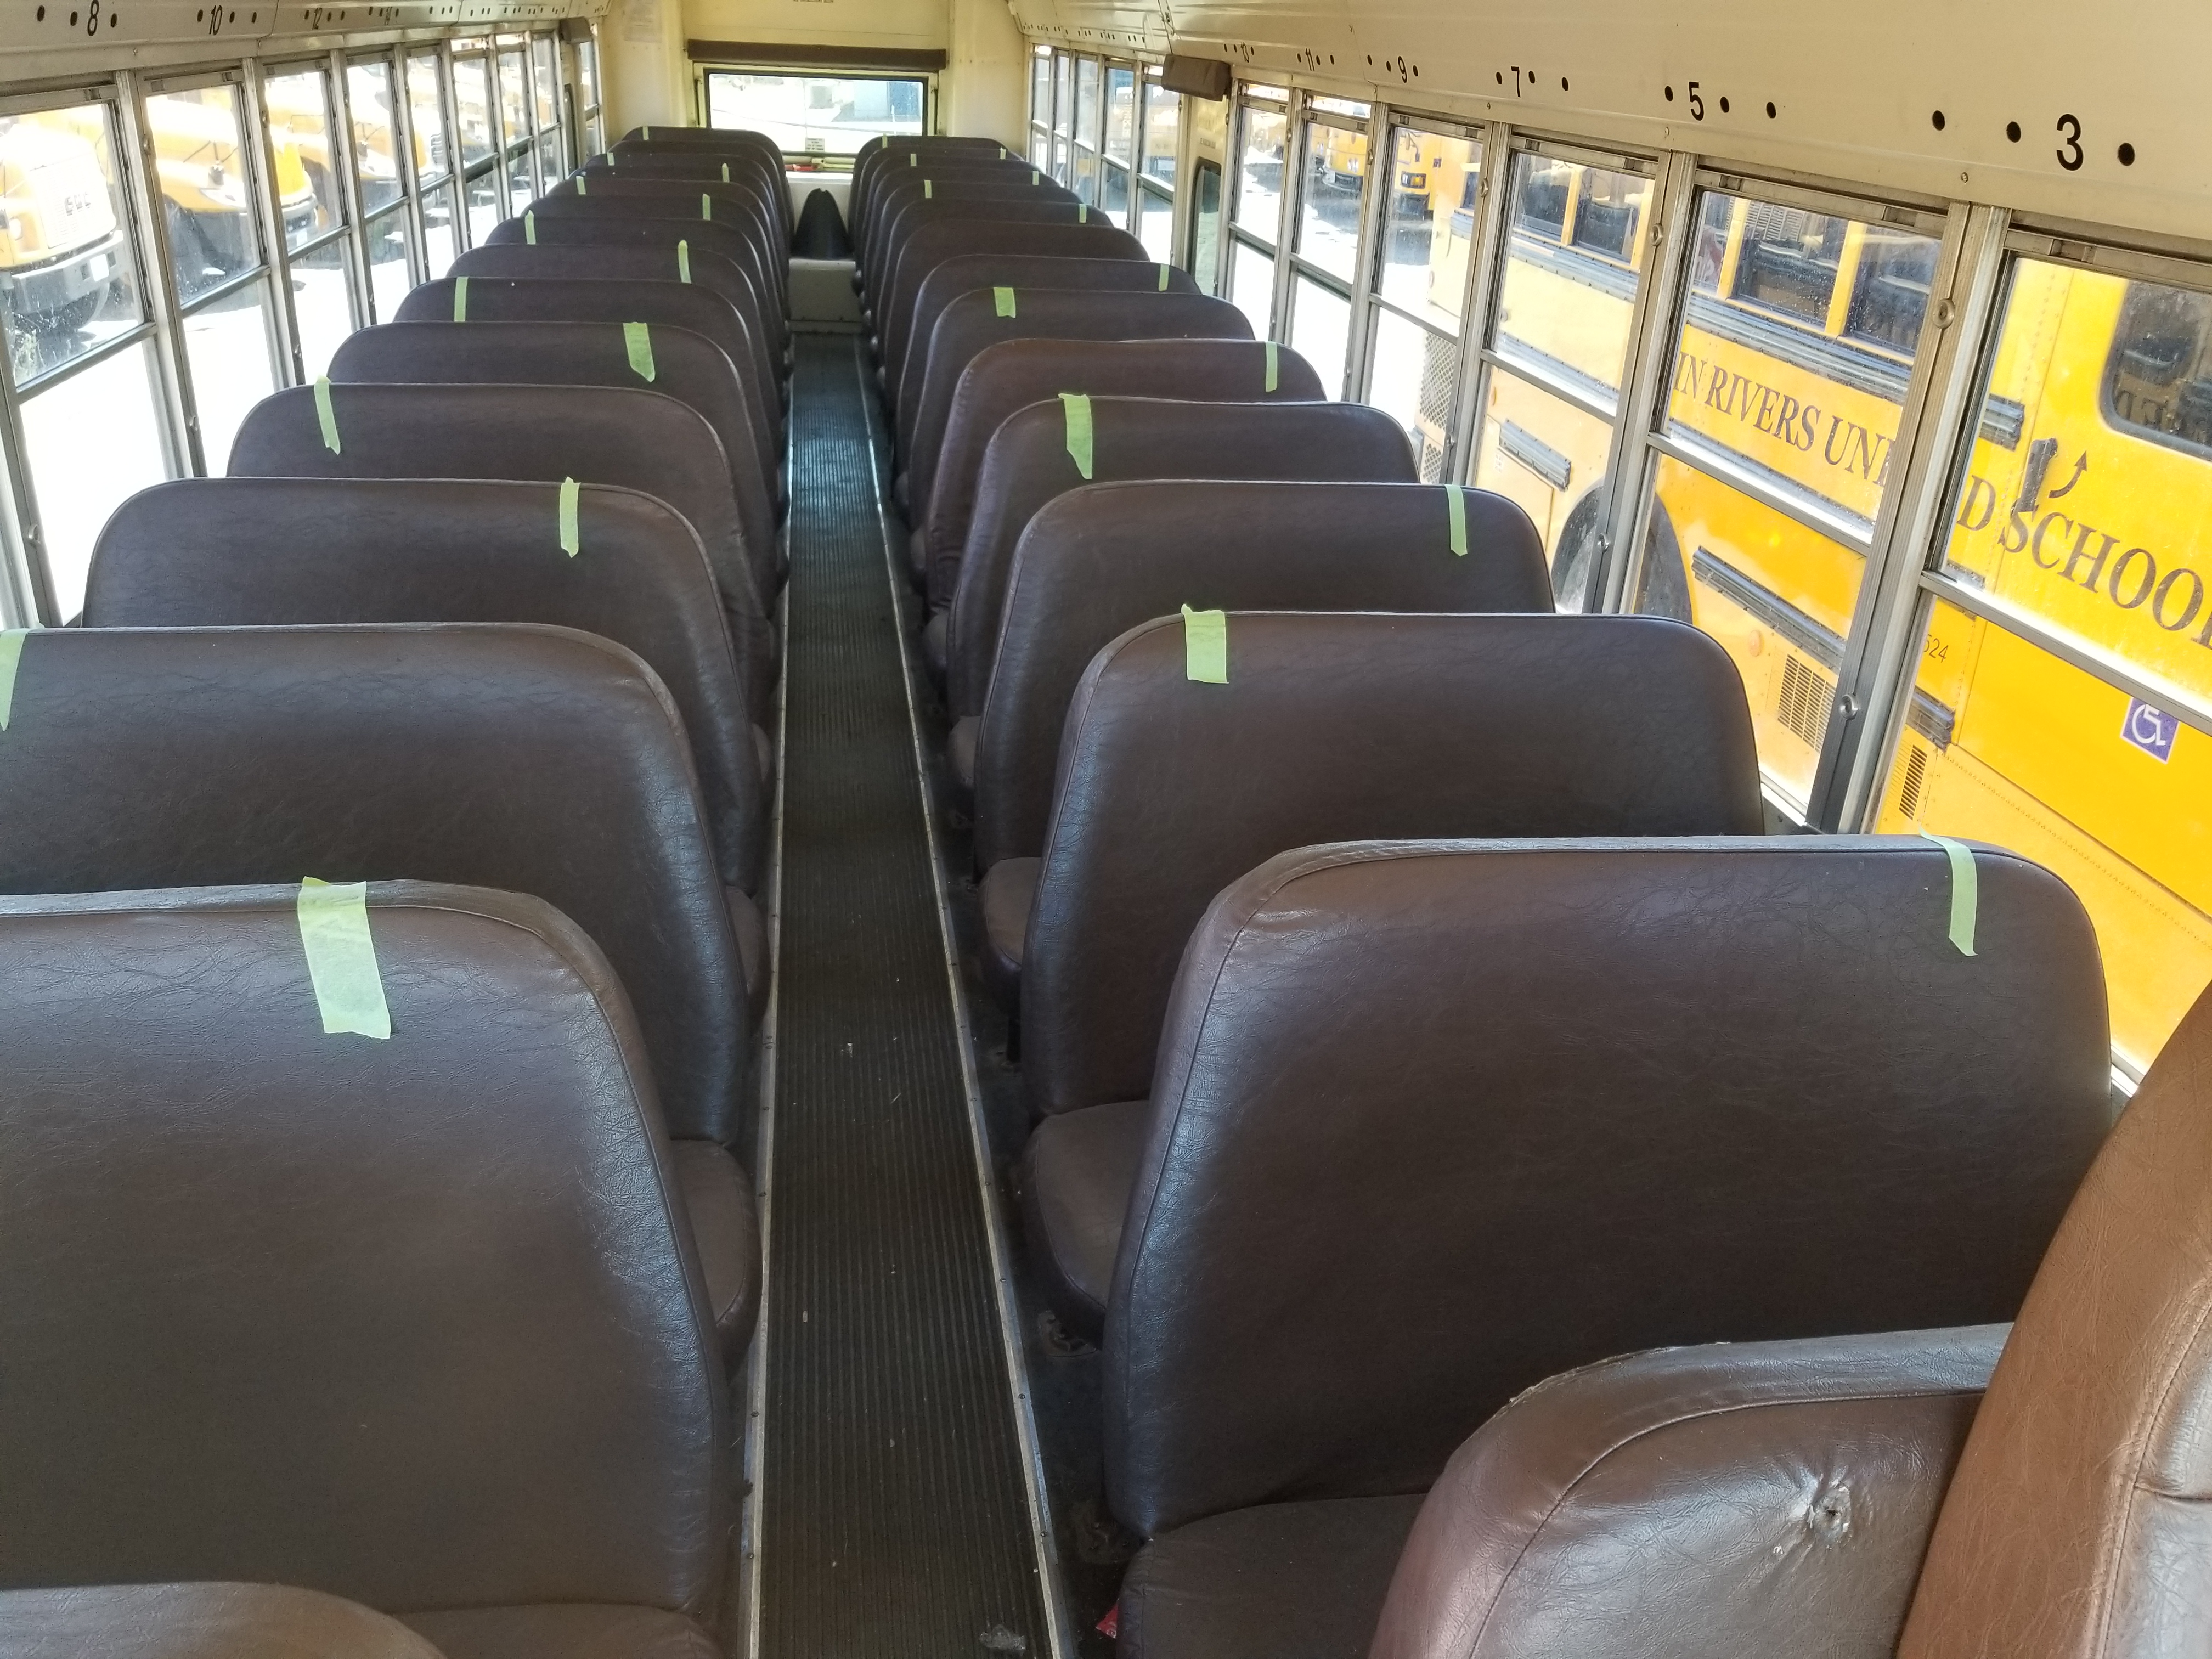
Seating Arrangement
– Every other seat

Slide 11
Passive Screening
Drivers and Students
- Nancy Jensen, Ca State Certified School Bus Driver Instructor

Slide 12
Passive Screening for Drivers & Students
Checklist
Do you have any of the following?
If you answer yes to any of the below, please contact the manager or school. Do not come into work or school until you have been medically cleared to return to work or school.
□ Fever or chills
• Anyone with symptoms of acute respiratory illness should notify their supervisor and stay home until they are free of fever (100.4° F [38.0° C] or higher using an oral thermometer), have signs of a fever, and any other symptoms for at least 24 hours, without the use of fever-reducing or other symptom-altering medicines (e.g., cough suppressants).
□ Cough
□ Shortness of breath or difficulty breathing
□ Fatigue
□ Muscle or body aches
□ Headache
□ New loss of taste or smell
□ Sore throat
□ Congestion or runny nose
□ Nausea or vomiting
□ Diarrhea

Slide 13
Passive Screening for Drivers & Students – Continued
Are you ill, or caring for someone who is ill?
• Employees/students who are well but who have a sick family member at home with COVID-19 should notify their supervisor and stay home.
• If an employee/student is confirmed to have COVID-19, employers should inform fellow employees of their possible exposure to COVID-19 in the workplace but maintain confidentiality as required by the Americans with Disabilities Act (ADA).
In the last two weeks, have you?
□ Had contact with someone diagnosed with COVID-19?
□ Live in or visit a place where COVID-19 is spreading?

Slide 14
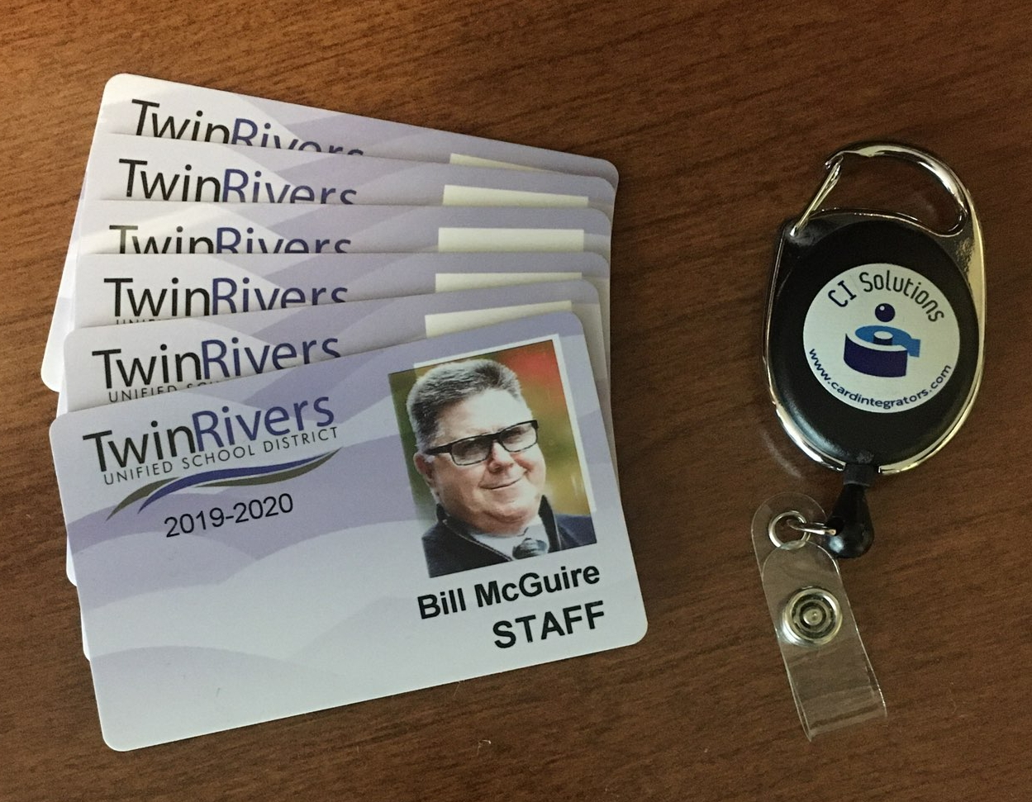
Bus pass/ID Card
How to obtain a card
– Timothy Shannon, Director Transportation Services

Slide 15
Buss Pass/ID Cards
Students who need a card
All student who need a bus pass must request through the office manager at their school site.
School site must provide a current list of actual student riders wishing to ride for the current school year.
Initial bus passes will be printed by Transportation and delivered to the office managers for further distribution.
In 2020/2021 - High School students see your school office manager. All others ask your bus drivers.

Slide 16
Communications
Parents, Students, and Staff
– Victoria Sanchez, Manager Transportation Services

Slide 17
Communication – outlets
Checklist
Communications for the information pertaining to Transportation should be available through the Transportation website.
Gen Ed Route Schedules
Stop location per address through Find My Bus Stop
Information on how to apply for a bus pass and procedure for bus pass usage
Special Needs Students/Families will receive schedule information via mail.
COVID-19 sanitizing and cleaning process (flyer)
Bus Rules and Regulations
Information on the My Stop App for Student Tracking for Parent use only. (Highly Recommended for communications)
Late bus notifications via My Stop App for both parents and schools.
Estimated arrival time to stops for My Stop Users.

Slide 18
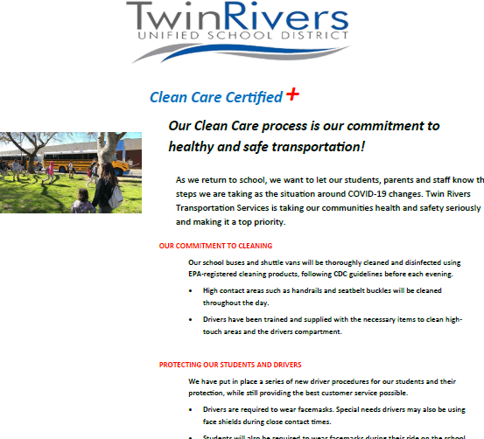
Informational Handout for Parents, Students & Staff
Clean Care Certified
OUR COMMITMENT TO CLEANING
PROTECTING OUR STUDENTS AND DRIVERS
RIDING WITH CONFIDENCE

Slide 19
Communication – Continued
Contact Department
Transportation Office Staff Support
Office staff is available by phone for immediate questions or concerns not addressed or available on the Transportation Website at 916-566-3405

Slide 20
Routes and Schedules
Special Needs Students & General Education
- Victoria Sanchez, Manager Transportation Services

Slide 21
Special Needs Students & General Education-
Routes and Schedules – See the Transportation website for updates
The Transportation Department has worked in collaboration with the Special Needs Department to call parents of students who are planning on returning to school in person in order to determine ridership for the upcoming 2020-2021 school year.
Results of calls were recorded on a spreadsheet and sent to the Special Needs Dept for further TIS form processing.
Parents who did not receive a call or if their student is a new enrollment should contact the Special Needs Dept @ 916-566-1600 Ext. 33319
Change of address or services should contact the Special Needs Dept for processing.
Special Needs Department calls the parent for follow up on creating a current TIS form verifying the most current information.
The TIS form is filled out in Laserfiche and submitted for review by the Transportation Dept.
Once approved by the Transportation Dept, the request will upload overnight and ready for routing the next day.
Once Transportation has scheduled the student and determined a start date, notifications will be made to the parent and the school by either a phone call or email.
General Education Route Schedules will be available on the Transportation Website and letters to Special Needs Students will be sent out once a return to school phase has been determined.

Slide 22
School Site Support
Student drop off
- Timothy Shannon, Director Transportation Services

Slide 23
School staff site support -
Student drop off
To transport students in a safe and timely manner, it is essential that we have the support of our school site staff:
Respectfully request that staff be present and available for accepting students at least 20 minutes before bell times.
Assist our buses in staying on schedule by providing support when arriving and departing the school property.
Assist in ideas to directing traffic if needed.

Slide 24
Questions
For Transportation Department Staff

